Slide 1
SMART HOME name : AHMED EMAM

Slide 2
Documentation For Project
Use Bluetooth module to transmit data to the first microcontroller
with communication protocol ( UART ).
Then send data from first microcontroller to second microcontroller
with communication protocol ( SPI ).
The first microcontroller is master and the second microcontroller is slave.
In the second micro we use the data taken through the SPI to light a led.
Use proteus to simulation the code.
Also use hardware circuits to test the code for a best results and we take a video for sure.

Slide 3
What is the project content ?
The project is divided into 3 sections:
MCAL
HAL
APP
In MCAL: DIO, UART, SPI
In HAL: LED
In APP: main.c

Slide 4
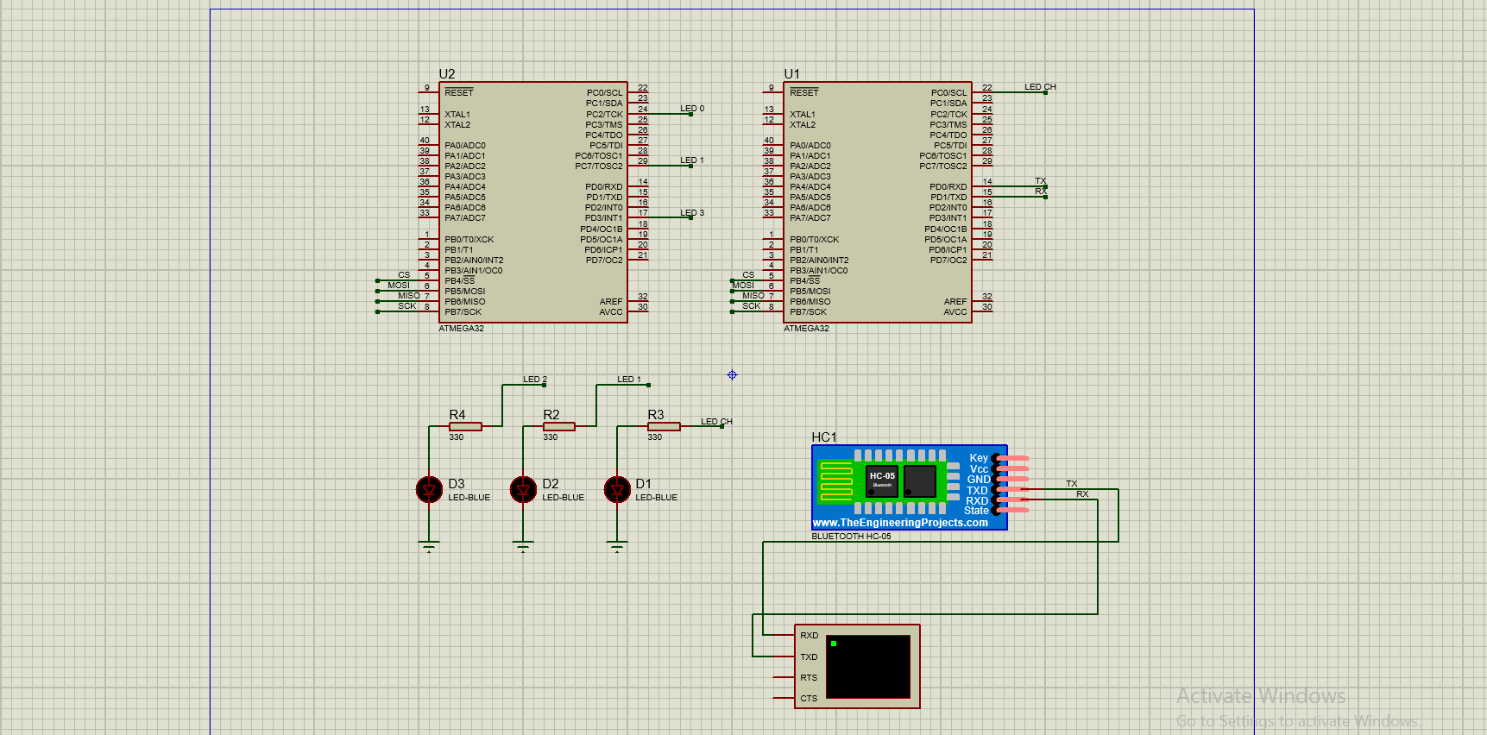
simulation

